Slide 1

Smart PG Finder
Group-18
High Four
Under the Mentorship of
Professor Anurag Lakhlani
Ahmedabad University
Section-2

Slide 2

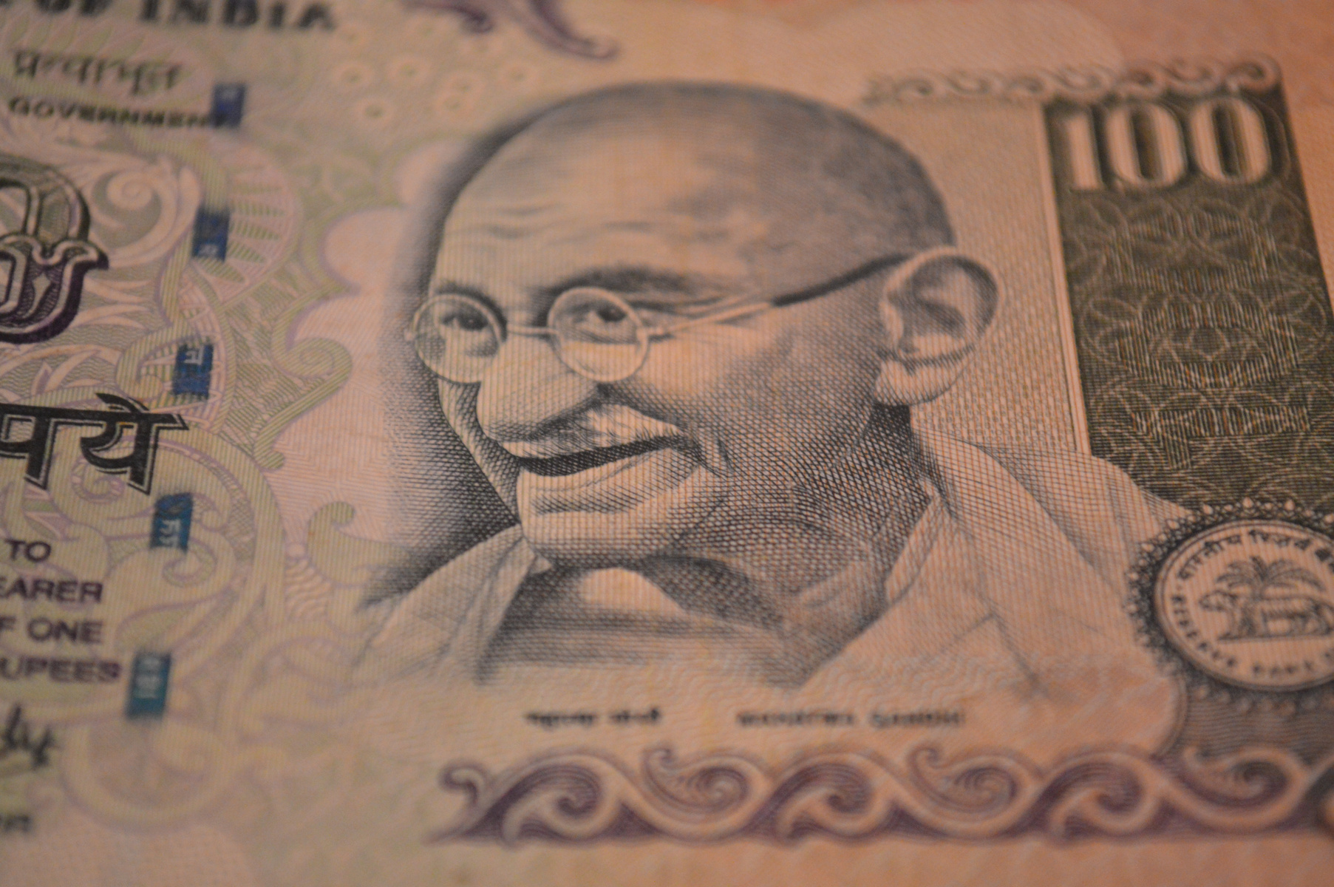


Smart PG Finder
Motivation
About 4 out of 10 college-going students leave their homes for further studies and move into new towns.
It becomes very difficult to find an affordable, good place to live which checks all the criteria for one who is moving to a new city.
About 3 out of 10 job seekers tend to leave their hometown to find a better opportunity in a new city

Slide 3
Smart PG Finder
SOLUTION 01
Searching and FIltering of Paying Guests (PGs) of user wish and criteria.
Project Overview
SOLUTION 02
Renting of PGs based on decided rates with multiple payments gateway.
Provide an all-in platform where users from searching the properties of their choice to renting the property can be done easily and with few clicks.
SOLUTION 03
Provide universal usability by making application or platform multilingual in nature

Slide 4
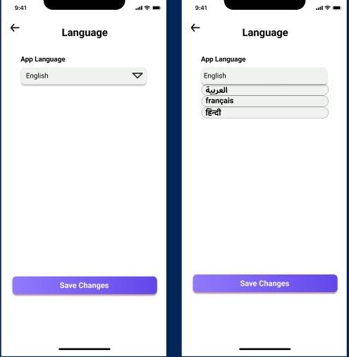
Feature-1
Providing the feature for the user to select a language other than providing only English, the user is provided the language in which he/she feels comfortable, which might remove the language barrier while using the PG finder application.
Design Principles / Universal Usability
1
Offer Informative Feedback
2
Cultural and International Diversity
Interaction Style
1
Menu Selection

Slide 5
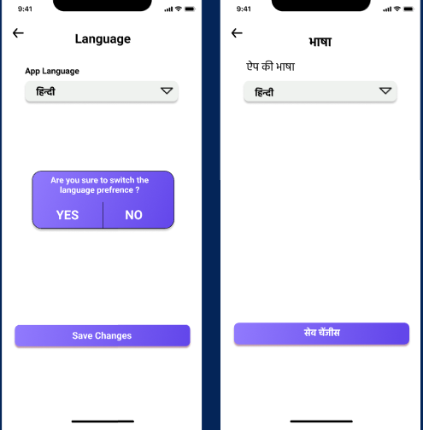
Feature-1
Hierarchy Task Analysis
Goal: Change in Language of PG Finder Application.
1.Select the language the user is comfortable with.
1.1 If users find the appropriate language and select it.
1.1.1 User saves the changes and continues using the app.
1.2 If the user did not find the appropriate language or selected a different language.
1.2.1 Users can cancel the changes made.

Slide 6
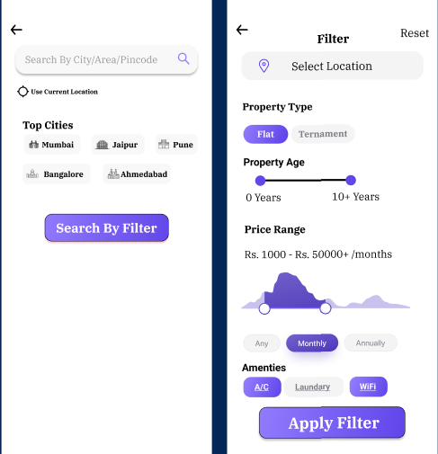
Feature-2
Providing the feature to search the nearby PG from the various search certiera provided by the user. Providing the feature to users to search by location
Design Principles / Universal Usability
Strive for consistency
Permit Easy Reversal of Actions
Support Intrval Locus of Control
Interaction Style
Direct Manipulation
Form Fill-in
Menu Selection

Slide 7
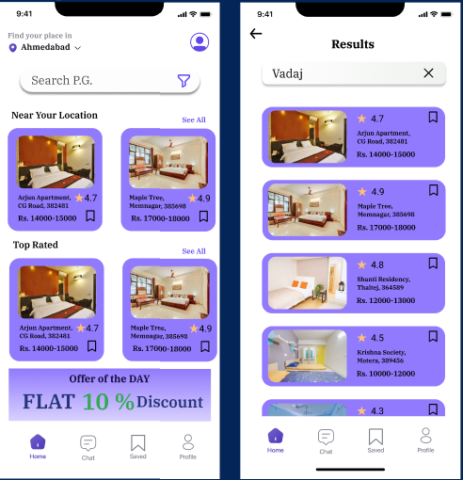
Feature-2
Hierarchy Task Analysis
Goal: Filter PGs list and search by location
1.Select the criteria that the user wants to find
1.1 If the user is satisfied with the search criteria then apply the search.
1.1.1 If the user is not satisfied with the criteria and misplaced then reset the filter
1.2 If the user wants to search by location then select the location
1.2.1 If the user doesn't want to type in location then search by current location

Slide 8
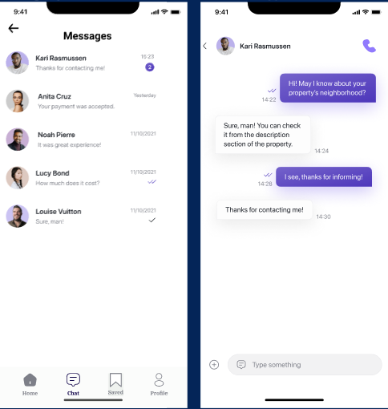
Feature-3
Providing the feature to the user to have a conversation with the owner of the PG to get some important details that are required for a PG Finder to know.
Design Principles / Universal Usability
1
Strive for Consistency
2
Reduce Short Term Memory Load
3
Support Internal Locus of Control
Interaction Style
Direct Manipulation
Menu Selection

Slide 9
Feature-3
Hierarchy Task Analysis
Goal: Chat with the owner of PG to get the necessary information
1. The user sends the doubts to the concerned owner.
1.1 Editing the message which is previously sent
1.1.1 Check whether the message after editing is not empty.
1.2. Deleting the message which is previously sent due to some error in typing.
1.2.1 Check whether the message is removed from both sides.
1.2.2 If the message is deleted successfully then show the message accordingly.
2. The user gets a reply message from the concerned owner.

Slide 10
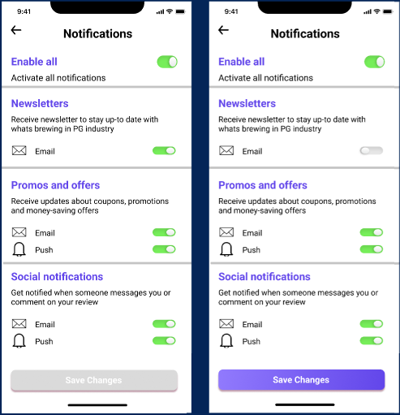
Feature-4
Providing the feature to the user for configuring the notification settings like which all notifications he/she wishes to receive and at which place.
Design Principles / Universal Usability
1
Offer Informative Feedback
2
Strive For Consistency
3
Support Internal Locus of Control
Interaction Style
Direct Manipulation
Form-Fill In

Slide 11
Feature-4
Hierarchy Task Analysis
Goal: Provide the user ability to select the notification he/she wants to get.
1. Select the notifications settings
2. Select the notification he/she wants to get by toggling the input.
2.1 If the setting is saved successfully then show the message accordingly.
2.2 If the setting is not saved successfully then show the message accordingly.

Slide 12
Smart PG Finder
The key challenge was to connect all of the web pages, which is referred to as wiring in Figma.
We watched various tutorials and sites which demonstrate how to conduct wiring in Figma inefficient, error-free, and time-saving manner, which aided us in completing the task.
Difficulty - 1
Wiring in The Figma
Difficulties encountered and how we solved
It was challenging to locate icons to add to Figma that were related to our functionality, such as the edit icon.
We then various online resources which provided the copyright-free icons in various sizes. So, used icons from these online resources
Difficulty - 2
Icons
Figma provides the best features for the design but somewhere lacking in designs that take input from the user like keyboard for typing, buttons, and switches. Users can only see the design but can't able to give inputs using those designs.
Then we figure that in Figma community blogs, we can try to add switches, and input dialog using components.
Difficulty - 3
Lack on integerating user interaction
Difficulties faced as a group and solution we brought as a group

Slide 13
Smart PG Finder
Due to the large no. of payment methods available nowadays is users are scattered some might use G-Pay, debit card, or credit card.
Therefore we have given various range of payment option available.
Also for users using a debit card and credit card, we added a feature that can remember card details so the user doesn't have to enter them every time for making a payment.
Implementation - 1
Regarding Payment method
Many times what happens is that 3rd parties give glimpses of the PG and basic facilities available in the PG.
But if the user wants to know details in real depth then connecting the user with the owner with help of the chat feature helps the user get more clarity over facilities, rules, regulations, and many more.
Implementation - 2
Real Life Implementation Perspectives
Clarity/
In-depth info
Implementation - 3
Huge number of Notifications.
Many times, users might not like the social notifications or notifications at all then we came with option that if user doesn't want notification at all then he can deactivate all notifications.
Real Life Implementation Perspectives which we came up as group decision

Slide 14
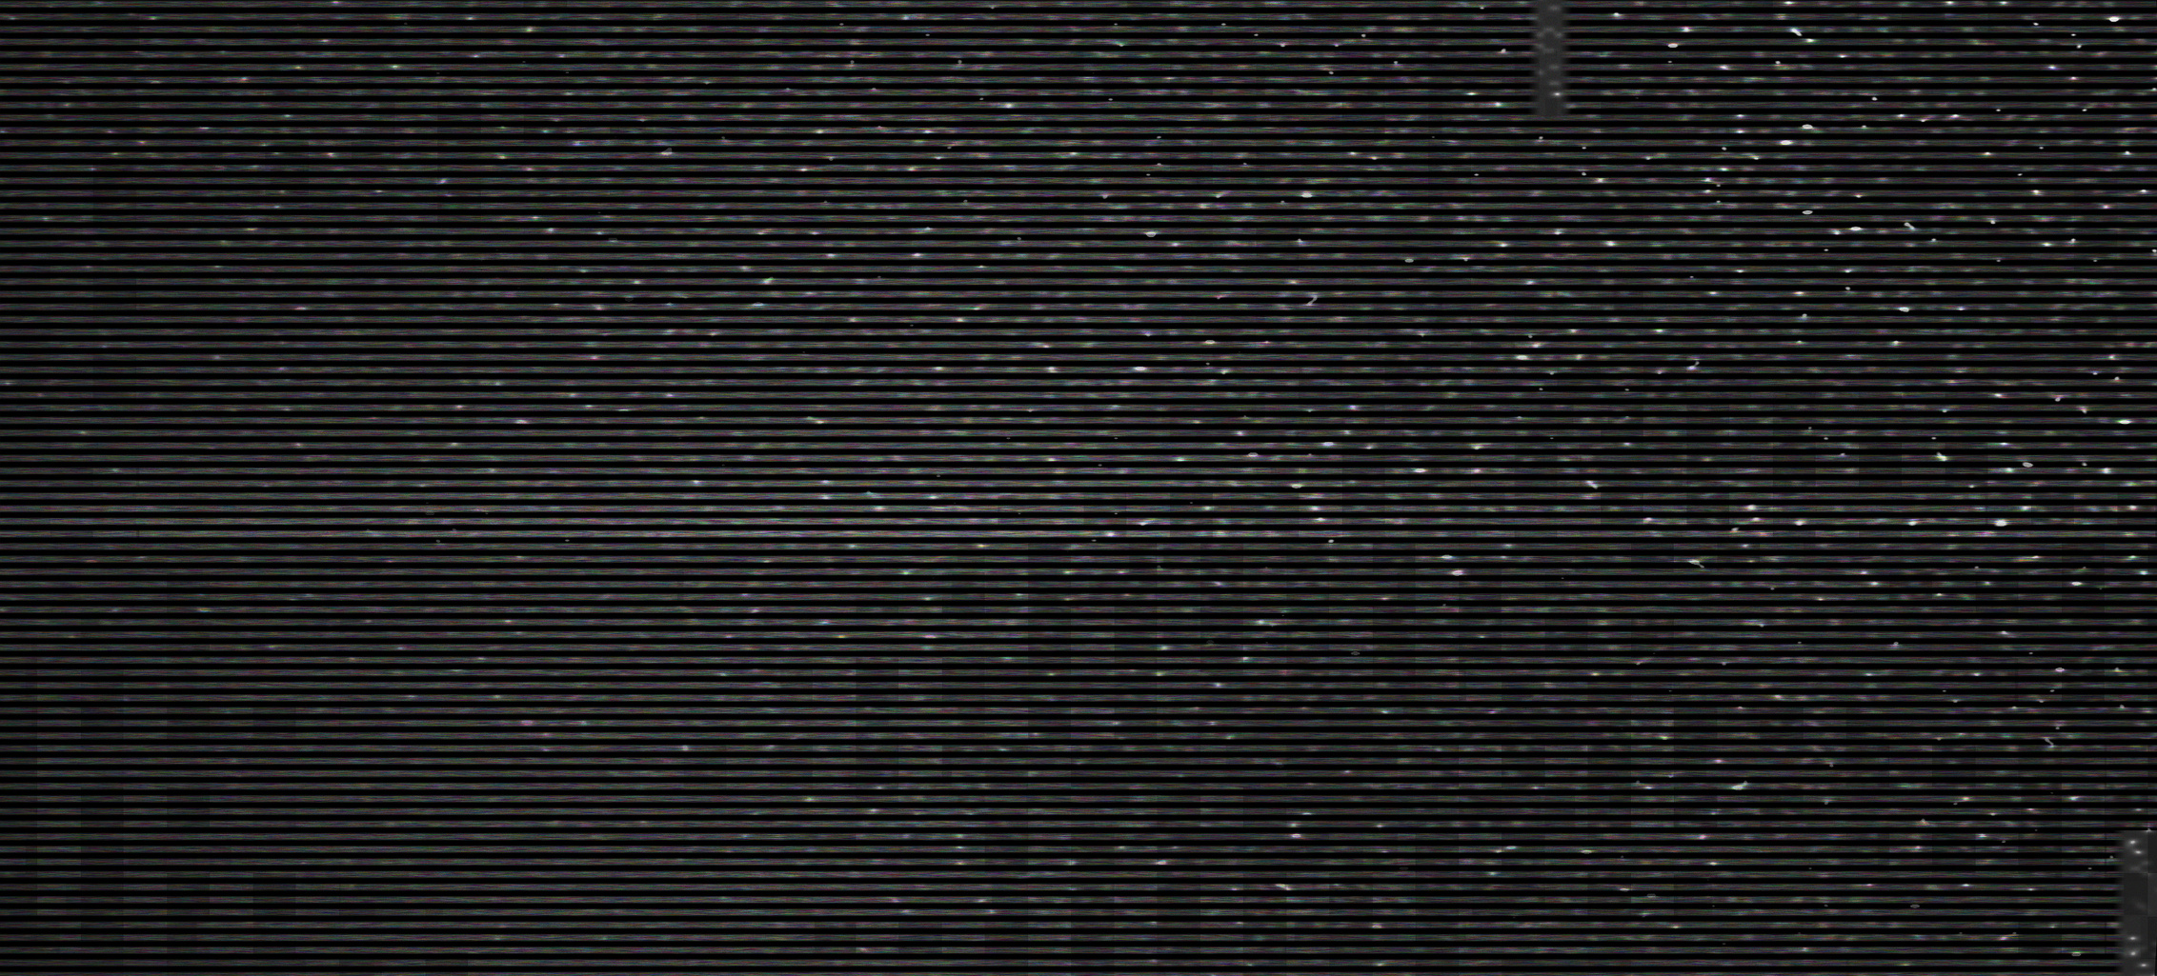
Project Video
Smart PG Finder

Slide 15

Smart PG Finder
Learning through PBL /ENABLE Component
Learning - 1
Learning - 2
Learning - 3
Learning about various designing tools example Adobe XD, Figma.
How user thinks when using an app and what is its perspective while using the application
Understanding between what is feasible to implement, ways to implement the mind ideas in real life with keeping understanding how interaction would be
Learning - 4
How to understand pain points of user for a given problem and quantify and measure it

Slide 16
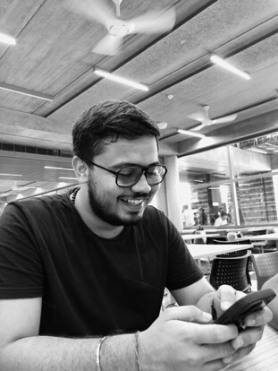
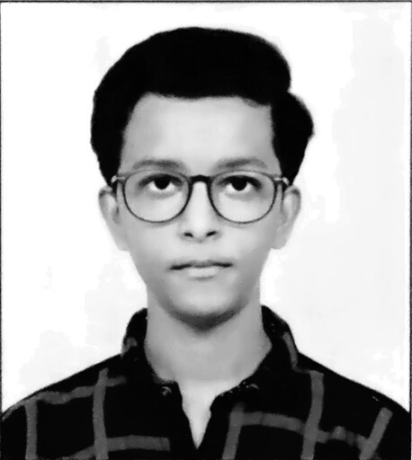
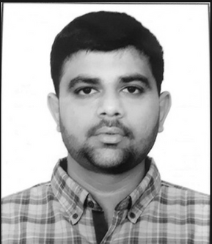
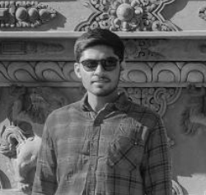
Thank You
JAP PUROHIT
MOHIT PRAJAPATI
PURVAM SHETH
RAJ GARIWALA
AU1940109
AU1940171
jap.p@ahduni.edu.in
mohit.p1@ahduni.edu.in
AU1940151
AU1940118
purvam.s@ahduni.edu.in
raj.g@ahduni.edu.in

